Slide 1
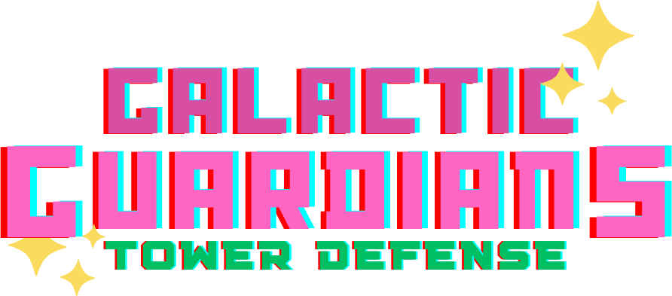
Project Beta

Slide 2
Team Members
Lennice Bolton
Dominic Ferrando
Kenneth Guzy
Gavin Hulvey
Nathon Iadimarco
Jacob Jericho
Minh Nhat Nguyen
Eva Powlison
Dylan Sarell
Priyank Shah
Yaseen Shaikh
Casey Shimko
Melissa Underwood
Jakub Wienczkowski

Slide 3
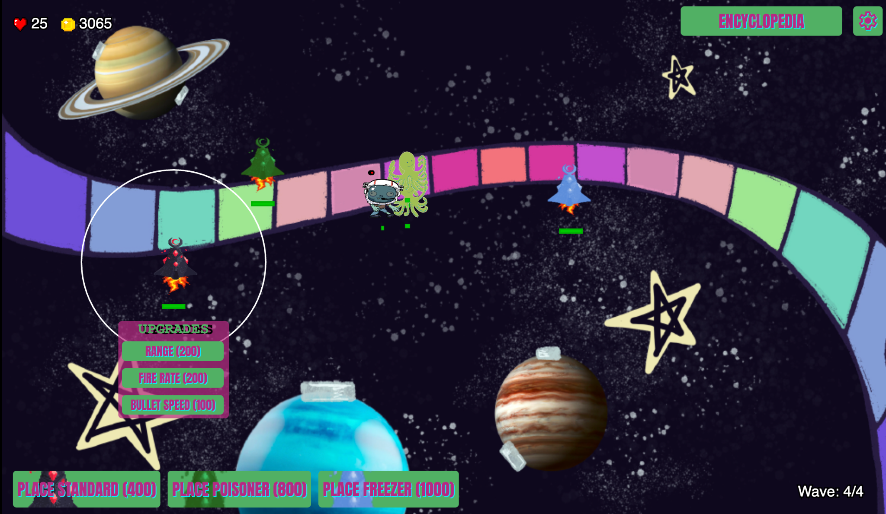
Description
The player places towers in areas on a game map
Enemies will come in waves
Towers will shoot at the enemies
Players will have to strategically upgrade their towers
The player needs to monitor their health and currency
The game is split into multiple waves and levels

Slide 4
Tutorial
https://dominicf2001.github.io/project-beta/

Slide 5




Technology
P5JS
CSS Styling
ES6 Modules
GitHub Projects
Fl Studio 21 (Music)
Krita (Static Images)
Photoshop (Static Images)
Canva (Graphic Design)
Spine (Animations)

Slide 6


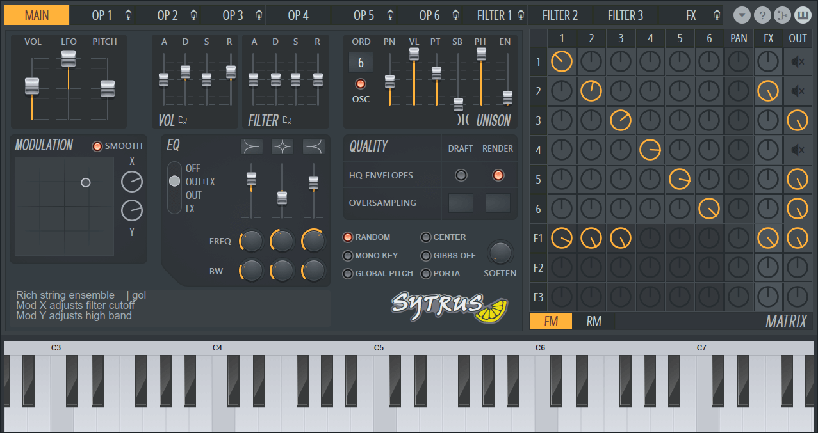
Art Direction: Audio
Software - FL Studio 21
Space themed, minor key but upbeat
Boss theme - inspired by Wellerman
Sytrus - main VST (Virtual Studio Technology)
Additional VSTs - Harmor, Toxic Biohazard

Slide 7
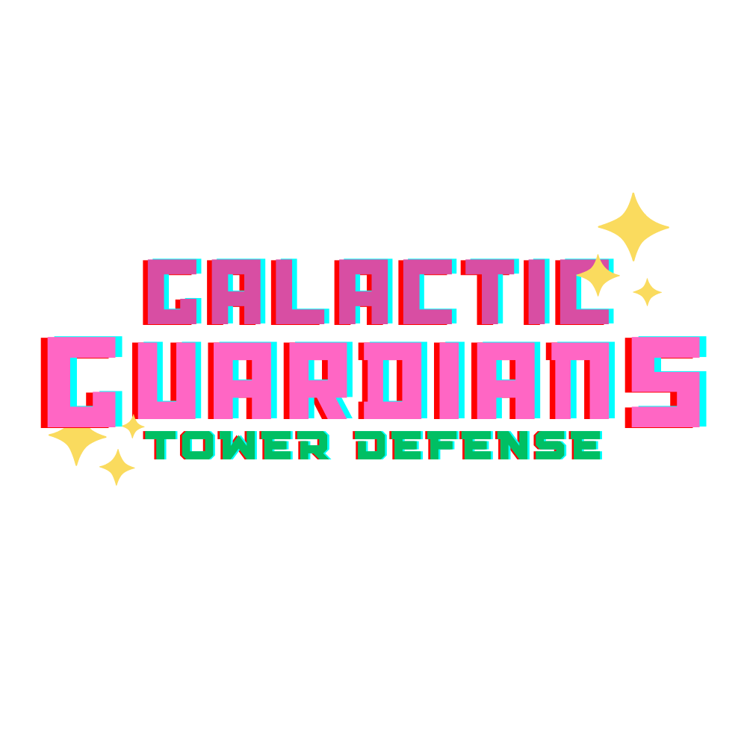
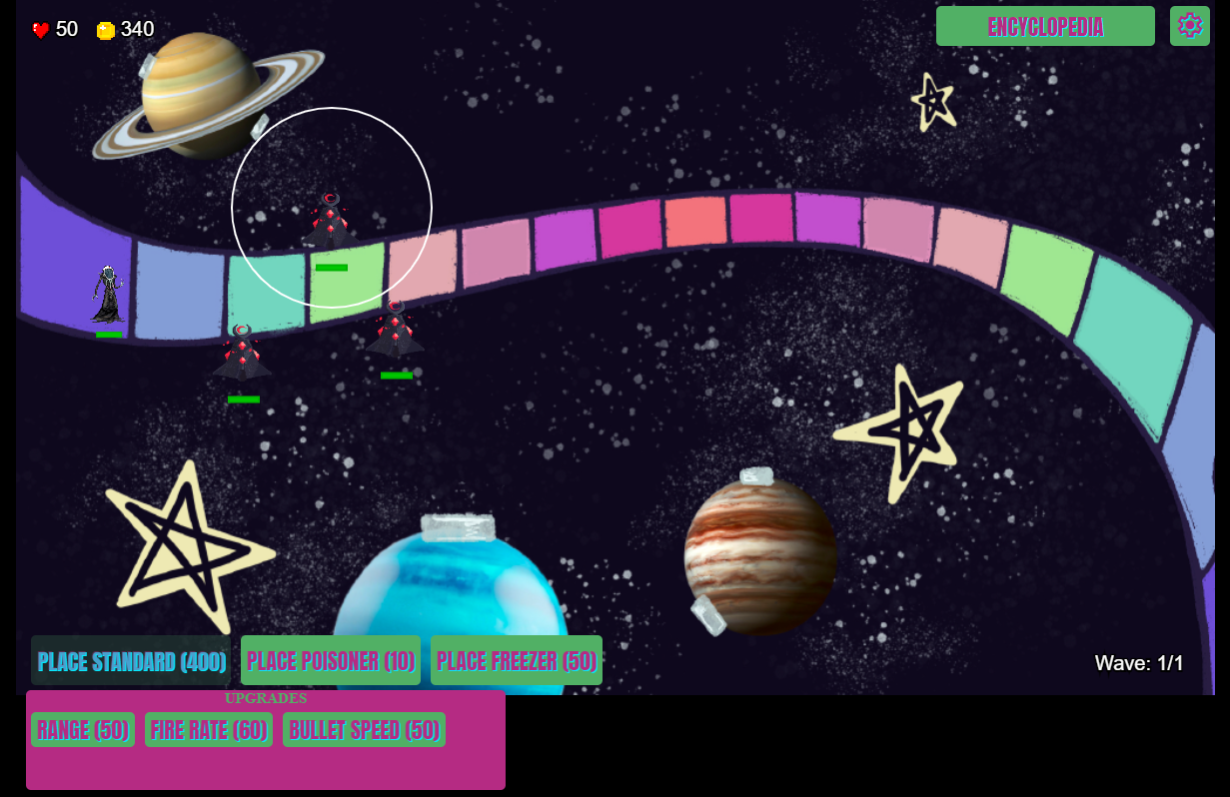
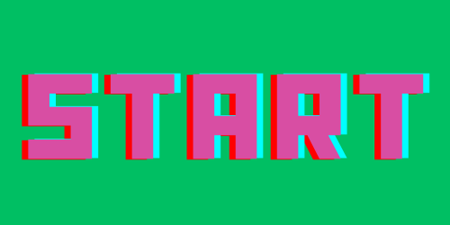
Art Direction: Visual
Retro
Whimsical
Hand drawn maps using:
Procreate
Google slides
Microsoft Paint

Slide 8
Teams
We decided it would be best to split our group into multiple sub teams concerned with:
Towers
Enemies
Maps
User Interface (UI)

Slide 9
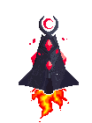
Towers
There are three different types
Implemented using subclasses
They can only be placed in certain areas on the map
Collider will restrict placement
The player can apply different upgrades
Bullet speed
Range
Fire Rate
Function in parent class

Slide 10
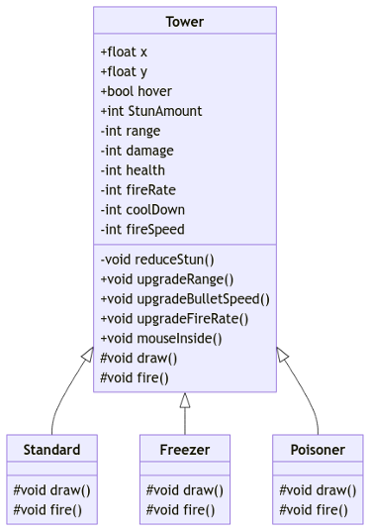
Tower Class UML

Slide 11
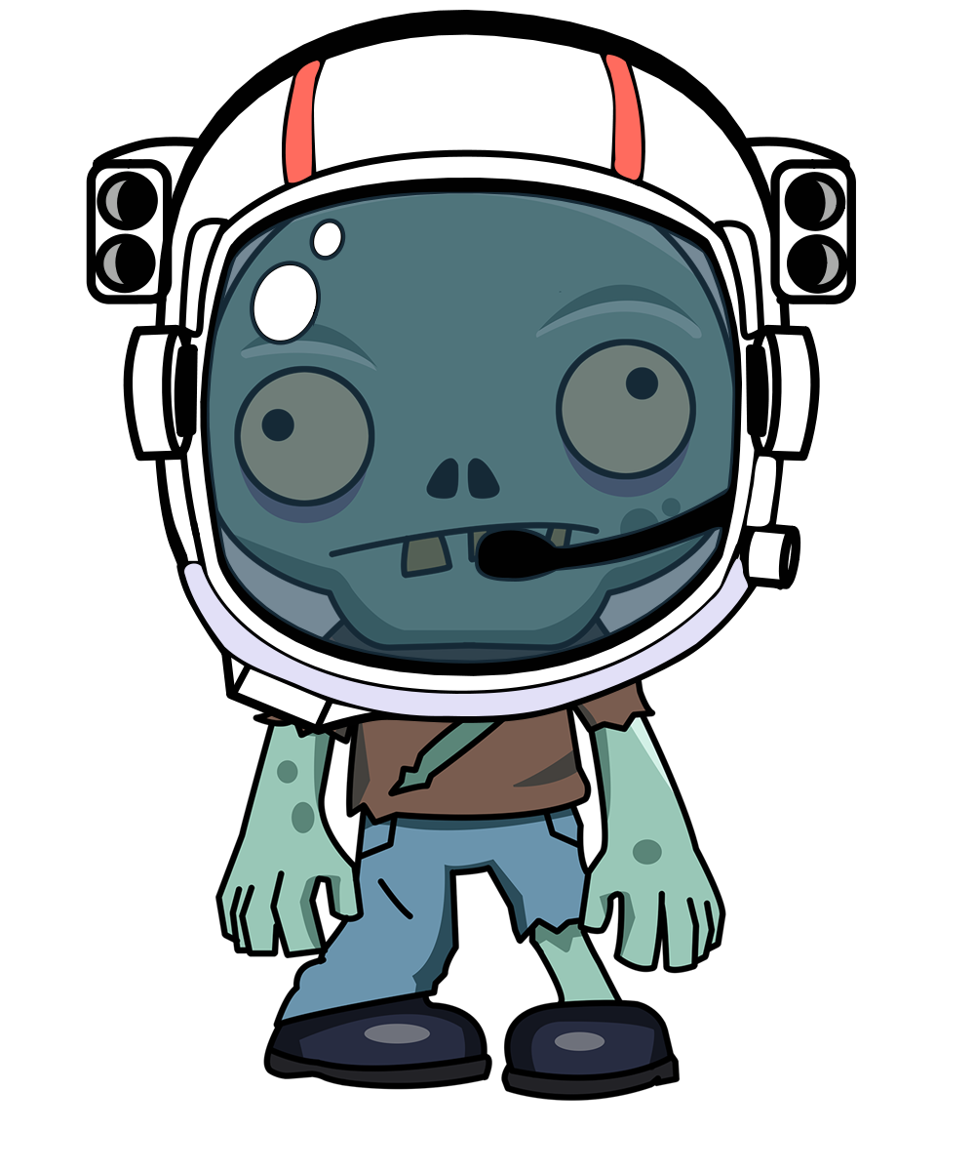
Enemies
There are five different types:
Standard Zombie
Summoner
Summonee
Tank
Boss
Implemented using subclasses
Are spawned in waves
All enemies need to be defeated or reach the end to start the next wave
Will only travel along a path
Have an verticality offset at spawn to avoid collision

Slide 12
Maps
The game has 3 playable maps:
Space Walk Map
Spaceship Map
Pirate Themed Alien World Map I Guess
Each Map has its own path that the enemies spawn on and follow. Different waves of enemies and placements for towers. There’s also different music.
The Map information is tracked via a map-id. You can switch between the multiple maps. Map-id is used as an index to get the information.

Slide 13
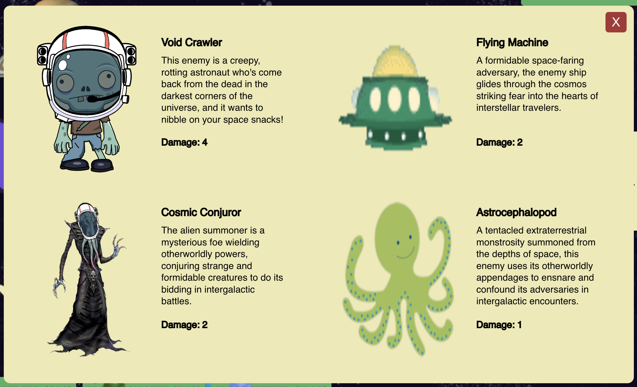
UI
Title screen buttons - Start, load Save, select map, and tutorial.
Tower Types/Selection Buttons
Tower Upgrades menu
Settings Menu
Next Level Button
Encyclopedia

Slide 14

Testing
A couple unit tests with MochaJS
Automated testing with Selenium and Python
Uses a debug console to gather information
Results reported using pytest

Slide 15

Feedback Video
We thought to record tests and make our results a little more personal and fun!

Slide 16
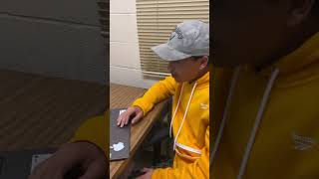

Slide 17
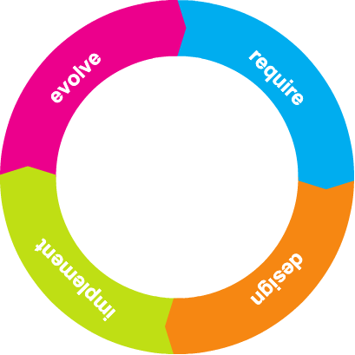
What We Learned
Project management
Technical collaboration
Agile development
Source code management with GitHub
A lot of JavaScript

Slide 18
Demo
https://dominicf2001.github.io/project-beta/

Slide 19
Feedback
Difficult to grasp at first but enjoyable with time
Helpful tutorial
Lots of creative art work
Really good music

Slide 20
Future Plans
Cash in existing towers
Add Stunner Enemy that stuns towers
Gemstone system
More levels
Ads
Microtransactions
Battle Pass
….
PROFIT

Slide 21
Questions?

